Slide 1
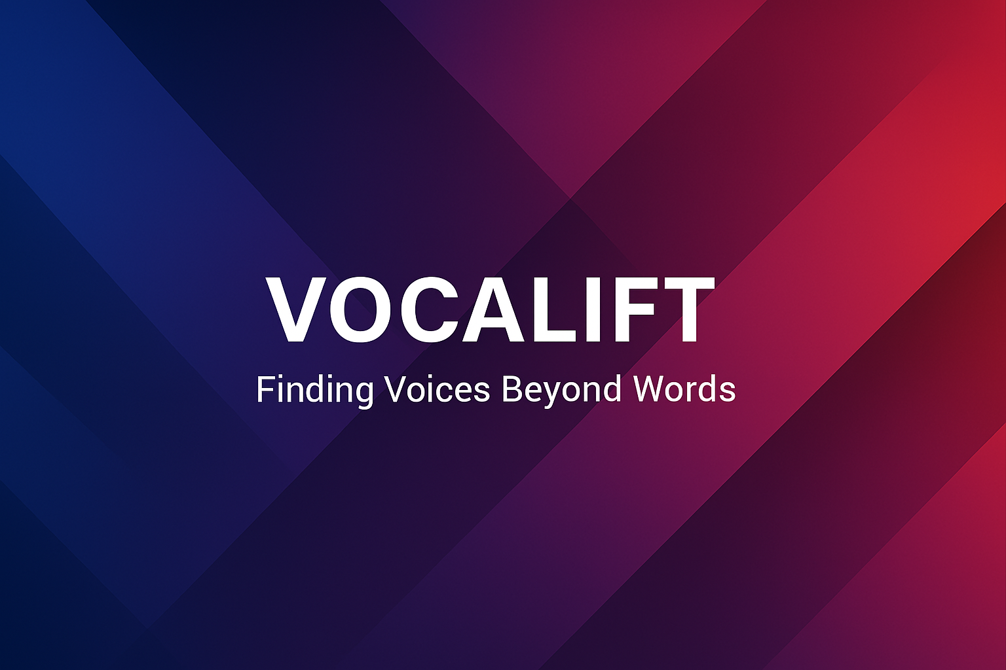
VocalLift
Presented By,
Jeevan Hebbal Manjunath
Date: March 30th, 2025
Giving Sound to the Unheard

Slide 2
AGENDA
1
The Problem
The Solution
The Demo & Tools
Market Trends
Trend Analysis
Target Audience
2
3
4
5
6

Slide 3

The Problem
Communication Barriers for Mute Individuals
70+ million people with speech disabilities
Current AAC tools are slow, robotic, and lack emotional nuance
Natural vocalizations (like hums) are underutilized

Slide 4
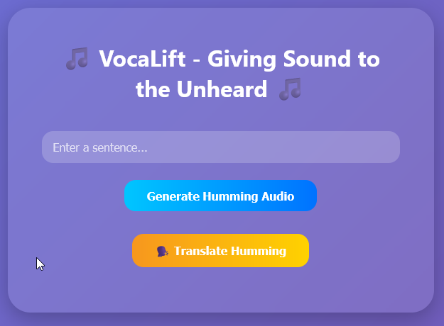
The Solution
Translates expressive humming into full phrases
1
2
Enables nonverbal users to communicate with natural rhythm and tone
Provides emotional and contextual understanding
3
4
Delivers phrase predictions and speech synthesis through a user-friendly interface (Real-time) in the future.

Slide 5
The Demo & Tools
AI Frameworks:
AudioGen – Generates expressive humming from natural language
librosa – Analyzes pitch and transforms audio to mel-spectrograms
1
Frontend/Backend:
Flask – Lightweight Python backend powering the API and web server
Vercel – Planned deployment platform for easy hosting and sharing
2

Slide 6
Understanding the market

Slide 7
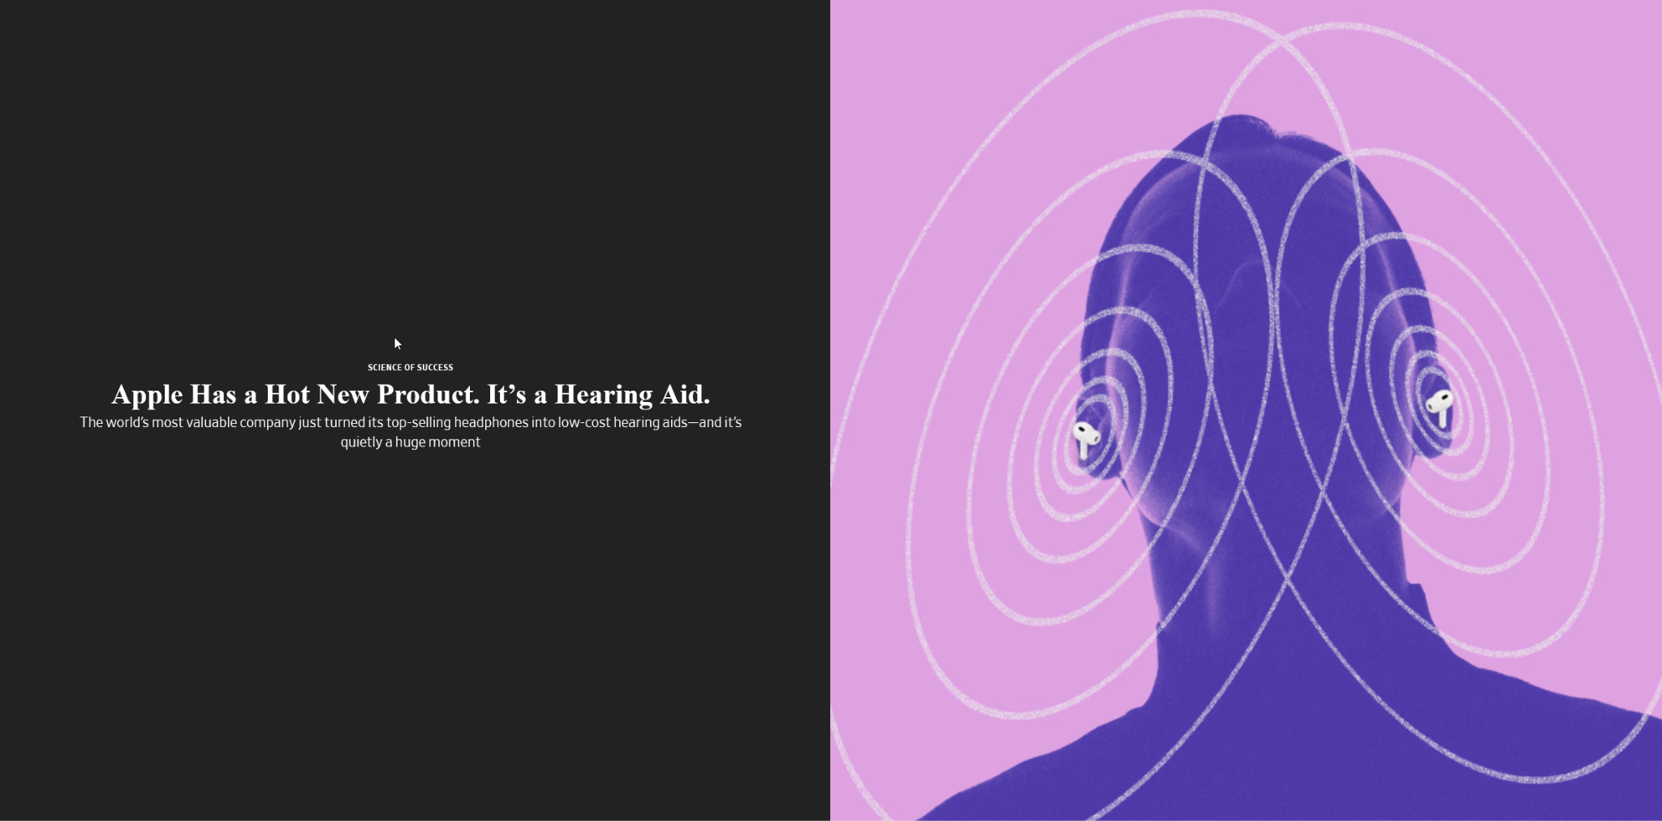
Market trends
01
Source: The Wall Street Journal

Slide 8
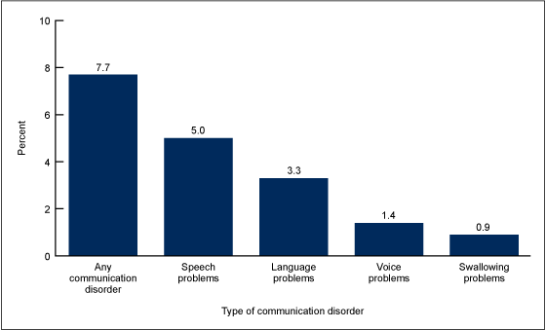
Market trends
01
Source: (CDC) National Center for Health Statistics

Slide 9
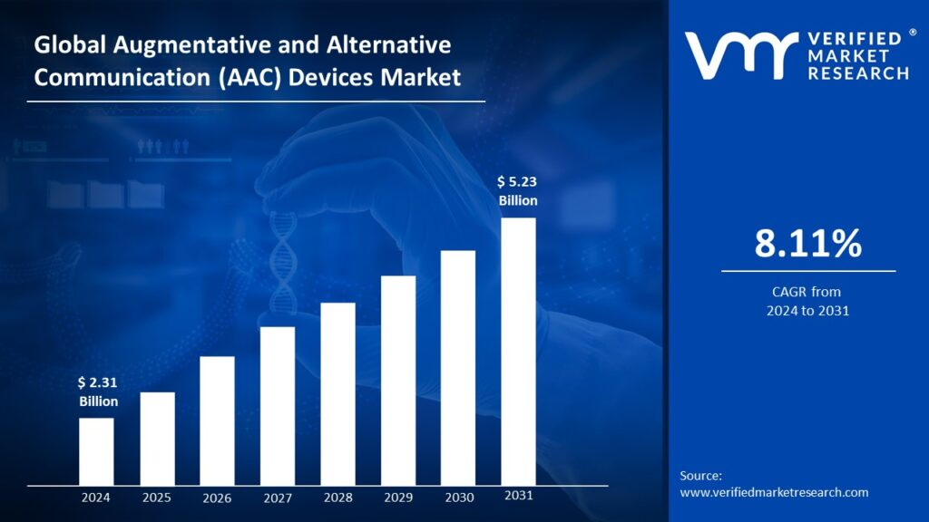
Trend analysis
Source: VerifiedMarketResearch

Slide 10

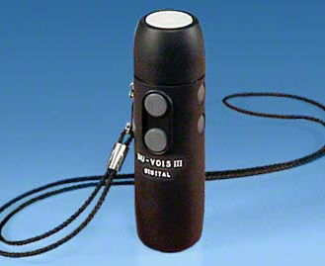

Target audience
01 | Speech Impairment Assistance
02 | AAC Support for Neurological Conditions
03 | Language Learning Tool
04 | Creative Music Composition

Slide 11
Thank you!

